Slide 1
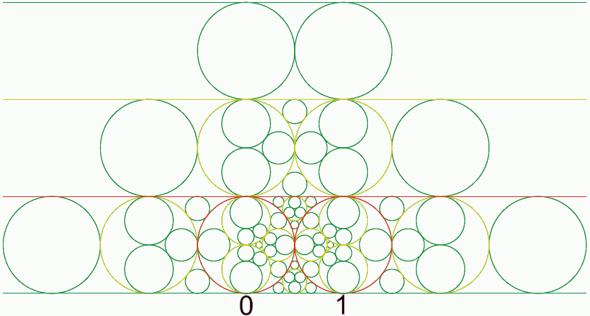
Visual Continued Fractions for teachers
Lance Burger
Math 250
Fresno State

Slide 2
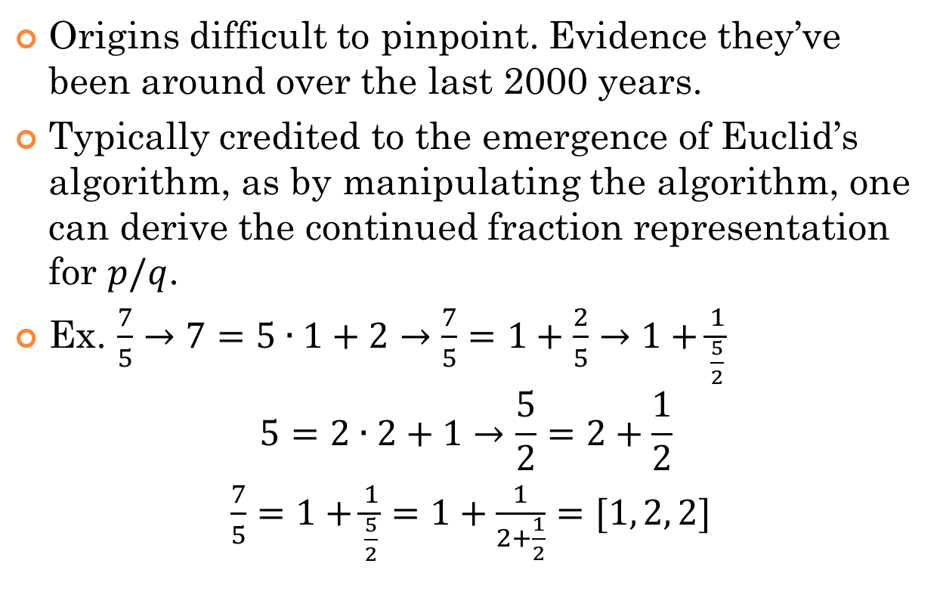
Some Background
Origins difficult to pinpoint. Evidence they’ve been around over the last 2000 years.
Typically credited to the emergence of Euclid’s algorithm, as by manipulating the algorithm, one can derive the continued fraction representation for $p/q$.
Ex. $\frac{7}{5}→7=5∙1+2→\frac{7}{5}=1+\frac{2}{5}→1+\frac{1}{\frac{5}{2}}$
$$5=2∙2+1→\frac{5}{2}=2+\frac{1}{2}$$
$\frac{7}{5}=1+\frac{1}{\frac{5}{2}}=1+\frac{1}{2+\frac{1}{2}}=[1, 2, 2]$

Slide 3
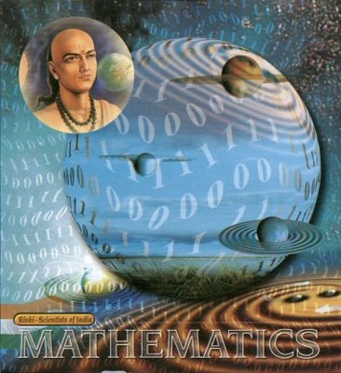
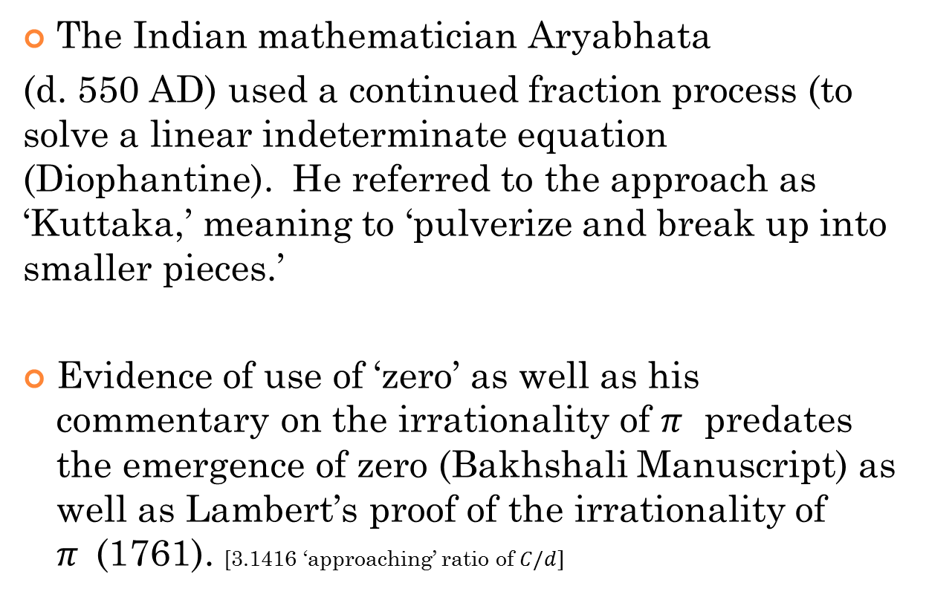
Some History
The Indian mathematician Aryabhata
(d. 550 AD) used a continued fraction process (to solve a linear indeterminate equation (Diophantine). He referred to the approach as ‘Kuttaka,’ meaning to ‘pulverize and break up into smaller pieces.’
Evidence of use of ‘zero’ as well as his commentary on the irrationality of $π$ predates the emergence of zero (Bakhshali Manuscript) as well as Lambert’s proof of the irrationality of $π$(1761). [3.1416 ‘approaching’ ratio of $C/d]$

Slide 4
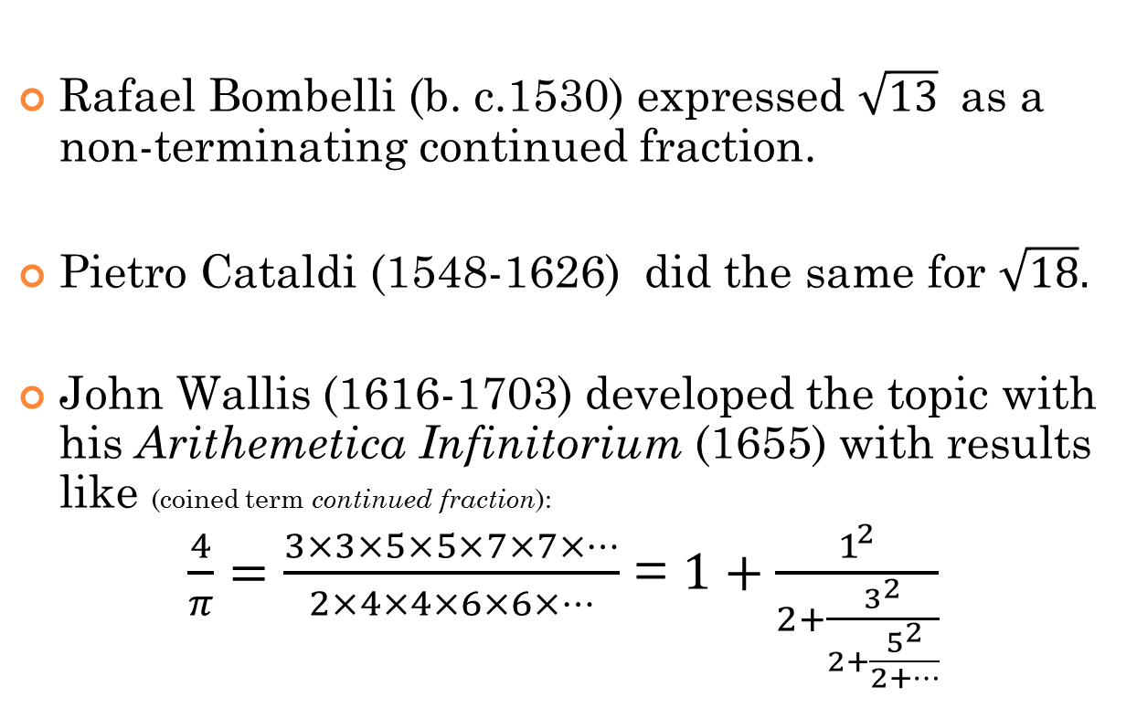
Some Background
Rafael Bombelli (b. c.1530) expressed $\sqrt{13}$ as a non-terminating continued fraction.
Pietro Cataldi (1548-1626) did the same for $\sqrt{18}.$
John Wallis (1616-1703) developed the topic with his Arithemetica Infinitorium (1655) with results like (coined term continued fraction):
$\frac{4}{π}=\frac{3×3×5×5×7×7×…}{2×4×4×6×6×…}$ = $1+\frac{1^{2}}{2+\frac{3^{2}}{2+\frac{5^{2}}{2+…}}}$

Slide 5
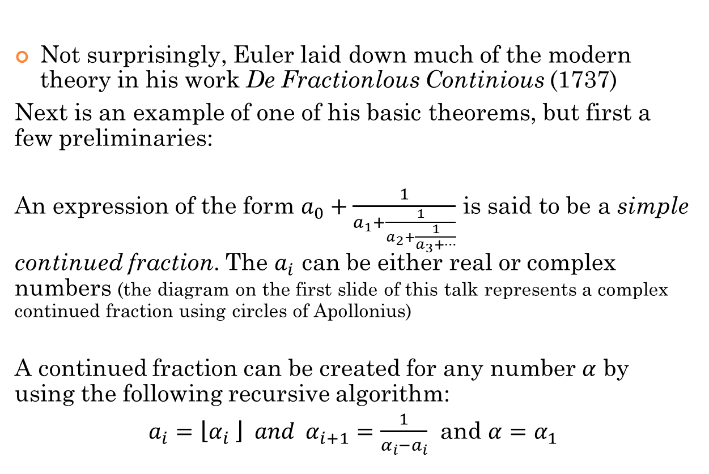
Some Background
Not surprisingly, Euler laid down much of the modern theory in his work De Fractionlous Continious (1737)
Next is an example of one of his basic theorems, but first a few preliminaries:
An expression of the form $a_{0}+\frac{1}{a_{1}+\frac{1}{a_{2}+\frac{1}{a_{3}+…}}}$ is said to be a simple continued fraction. The $a_{i}$ can be either real or complex numbers (the diagram on the first slide of this talk represents a complex continued fraction using circles of Apollonius)
A continued fraction can be created for any number $α$ by using the following recursive algorithm:
$a_{i}=\left\lfloor α_{i} \right\rfloor and α_{i+1}=\frac{1}{α_{i}−a_{i}}$ and $α=α_{1}$

Slide 6
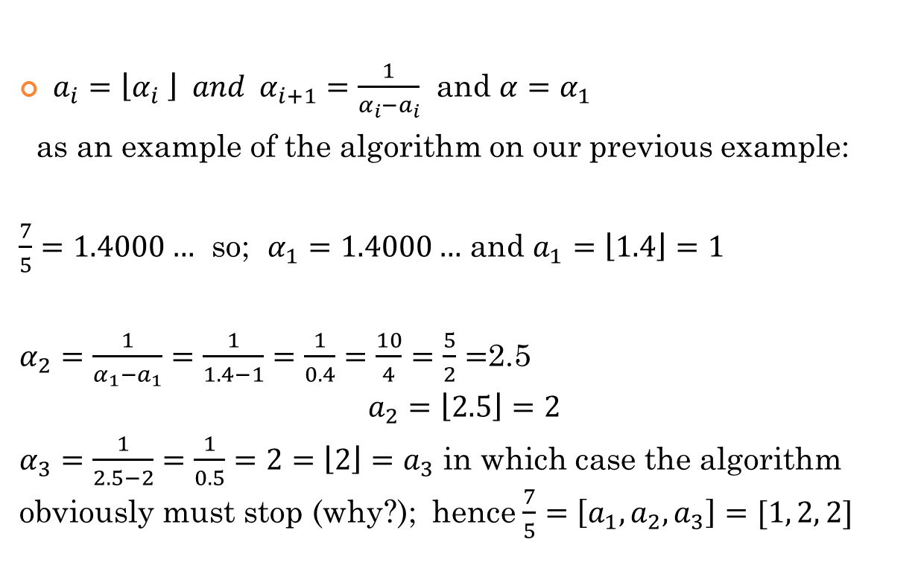
Some Background
$a_{i}=\left\lfloor α_{i} \right\rfloor and α_{i+1}=\frac{1}{α_{i}−a_{i}}$ and $α=α_{1}$
as an example of the algorithm on our previous example:
$\frac{7}{5}=1.4000…$ so; $α_{1}=1.4000…$ and $a_{1}=\left\lfloor 1.4\right\rfloor =1$
$α_{2}=\frac{1}{α_{1}−a_{1}}=\frac{1}{1.4−1}=\frac{1}{0.4}=\frac{10}{4}=\frac{5}{2}=$2.5
$$a_{2}=\left\lfloor 2.5\right\rfloor =2$$
$α_{3}=\frac{1}{2.5−2}=\frac{1}{0.5}=2=\left\lfloor 2\right\rfloor =a_{3}$ in which case the algorithm obviously must stop (why?); hence $\frac{7}{5}=\left[a_{1}, a_{2}, a_{3}\right]=[1, 2, 2]$

Slide 7
From Euler’s De Fractionlous Continious (1737):
Theorem 1: A number is rational if and only if it can expressed as a simple finite continued fraction.
Proof: By repeated use of the Euclidean algorithm:
p = a₁q + r₁, 0 <= r₁ < q,
q = a₂r₁ + r₂, 0 <= r₂ < r₁,
r₁ = a₃r₂ + r₃, 0 <= r₃ < r₂,
: : r_{n-3} = a_{n-1}r_{n-2} + r_{n-1}, 0 <= r_{n-1} < r_{n-2},
r_{n-2} = a_{n}r_{n-1}.
The sequence r₁, r₂, r₃,..., r_{n-1} forms a strictly decreasing sequence of non-negative integers that must converge to zero in a finite number of steps.

Slide 8

A few examples from Euler’s De Fractionlous Continious (1737)
Upon rearrangement of the algorithm:
$$\frac{p}{q}=a_{1}+\frac{1}{\frac{q}{r_{1}}}$$
$$\frac{q}{r_{1}}=a_{1}+\frac{1}{\frac{r_{1}}{r_{2}}}$$
$$⋮$$
$$\frac{r_{n−2}}{r_{n−1}}=a_{n−1}+\frac{1}{\frac{r_{n−1}}{r_{n}}}$$
$$\frac{r_{n−1}}{r_{n}}=a_{n}$$

Slide 9
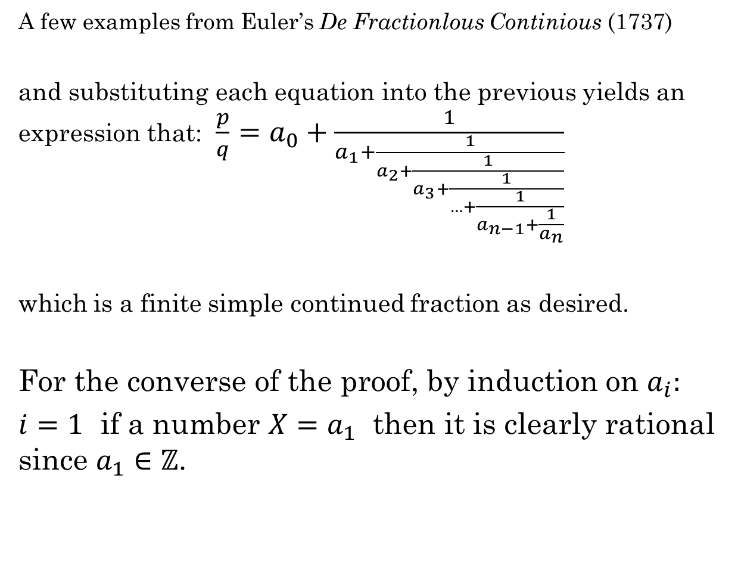
A few examples from Euler’s De Fractionlous Continious (1737)
and substituting each equation into the previous yields an expression that: ${\frac{p}{q}=a}_{0}+\frac{1}{a_{1}+\frac{1}{a_{2}+\frac{1}{a_{3}+\frac{1}{…+\frac{1}{a_{n−1}+\frac{1}{a_{n}}}}}}}$
which is a finite simple continued fraction as desired.
For the converse of the proof, by induction on $a_{i}:$
$i=1$ if a number $X=a_{1}$ then it is clearly rational since $a_{1}∈ℤ$.

Slide 10


${X=a}_{0}+\frac{1}{B}$ , where by inductive hypothesis B is rational
hence:
$$∴{X=a}_{0}+\frac{1}{\frac{p}{q}}=a_{0}+\frac{q}{p}=\frac{a_{0}p+q}{p}∈ℚ$$
${X=a}_{0}+\frac{1}{a_{1}+\frac{1}{a_{2}+\frac{1}{a_{3}+\frac{1}{…+\frac{1}{a_{n}+\frac{1}{a_{n+1}}}}}}}$

Slide 11
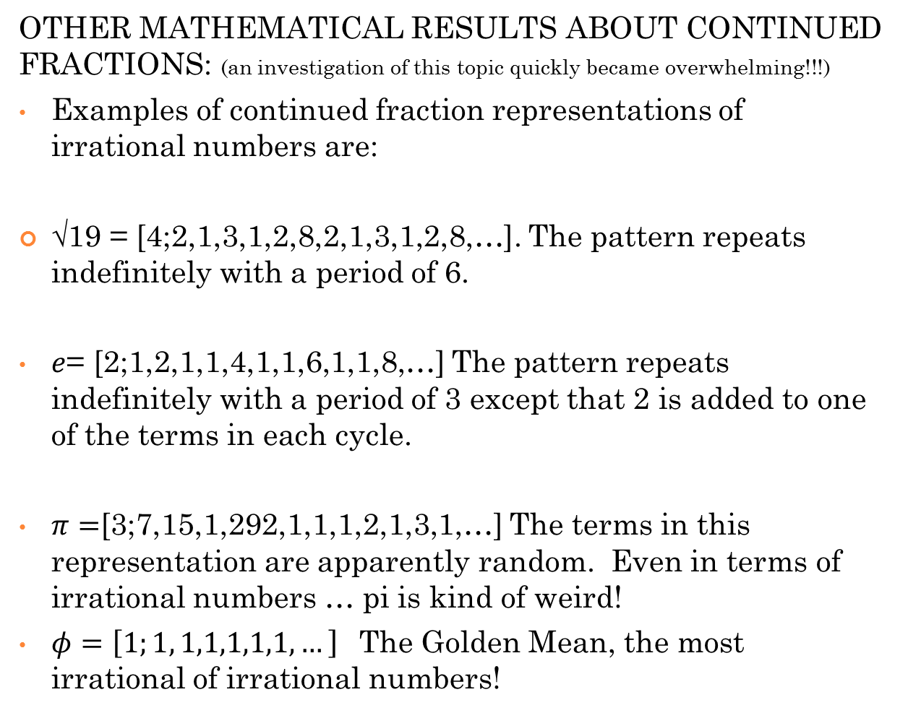
OTHER MATHEMATICAL RESULTS ABOUT CONTINUED FRACTIONS: (an investigation of this topic quickly became overwhelming!!!)
Examples of continued fraction representations of irrational numbers are:
√19 = [4;2,1,3,1,2,8,2,1,3,1,2,8,…]. The pattern repeats indefinitely with a period of 6.
$e$= [2;1,2,1,1,4,1,1,6,1,1,8,…] The pattern repeats indefinitely with a period of 3 except that 2 is added to one of the terms in each cycle.
$π=$[3;7,15,1,292,1,1,1,2,1,3,1,…] The terms in this representation are apparently random. Even in terms of irrational numbers … pi is kind of weird!
$φ=\left[1;1, 1,1,1,1,1,…\right]$ The Golden Mean, the most irrational of irrational numbers!

Slide 12
How continued fractions can be accessible and useful for pre-service school teachers
(i.e. Math 100 or Math 138)
Justifications: A mathematics Grade 3 Common Core Standard:
(4) Students describe, analyze, and compare properties of two dimensional shapes. They compare and classify shapes by their sides and angles, and connect these with definitions of shapes. Students also relate their fraction work to geometry by expressing the area of part of a shape as a unit fraction of the whole.

Slide 13
(2) Students develop an understanding of fractions, beginning with unit fractions. Students view fractions in general as being built out of unit fractions, and they use fractions along with visual fraction models to represent parts of a whole.
They solve problems that involve comparing fractions by using visual fraction models and strategies based on noticing equal numerators or denominators.
The first unit in Math 100 concerns models for operations with fractions. For this talk, the focus will be on
division with fractions.
The Measurement model is a ‘verbal model’ (Liping Ma) which threads through ALL of the other models for division discussed.

Slide 14
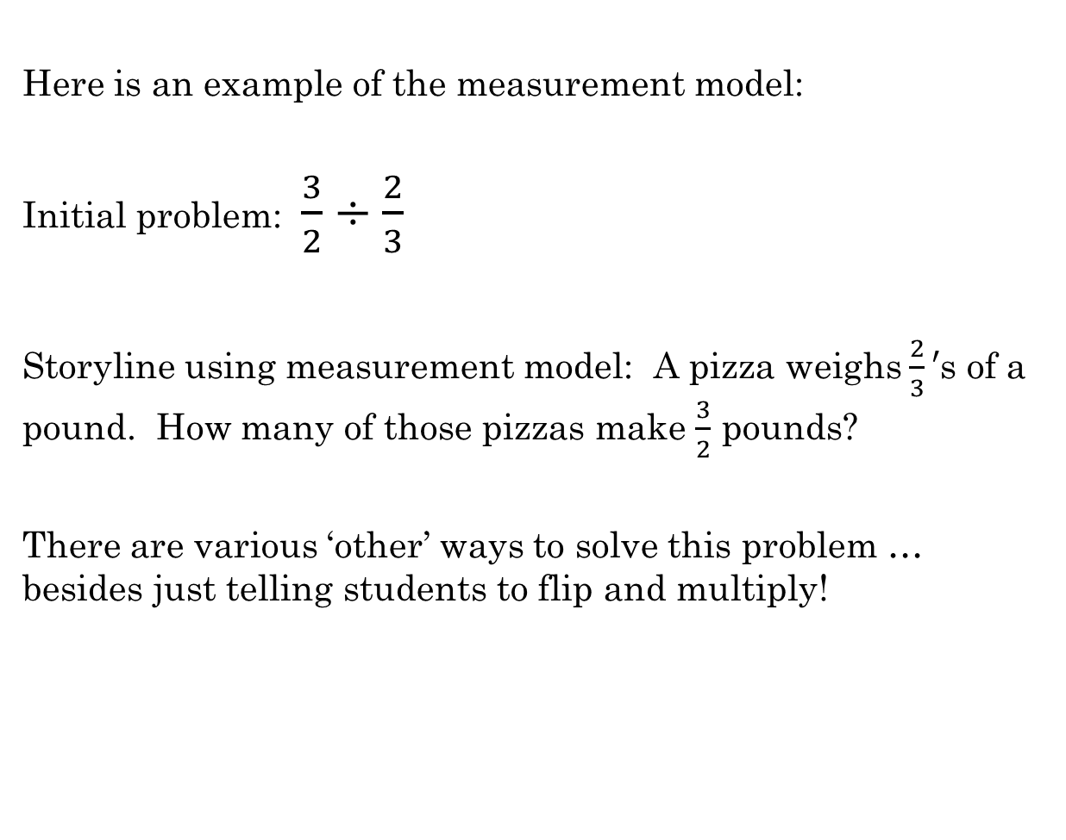
Here is an example of the measurement model:
Initial problem: $\frac{3}{2}÷\frac{2}{3}$
Storyline using measurement model: A pizza weighs $\frac{2}{3}′$s of a pound. How many of those pizzas make $\frac{3}{2}$ pounds?
There are various ‘other’ ways to solve this problem … besides just telling students to flip and multiply!

Slide 15


(1) One way is to use pattern blocks. *(Demonstration on board using two hexagons as a whole.)
$$\frac{3}{2}÷\frac{2}{3}$$

Slide 16
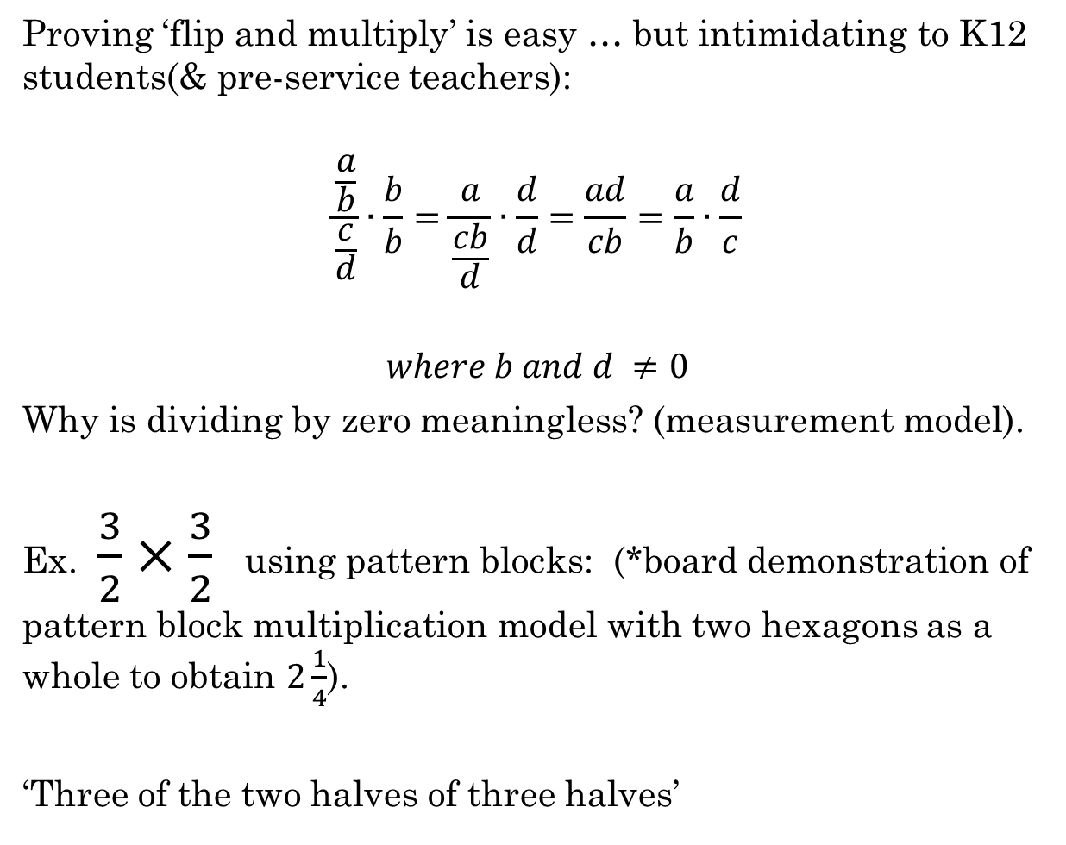
Proving ‘flip and multiply’ is easy … but intimidating to K12 students(& pre-service teachers):
$$\frac{\frac{a}{b}}{\frac{c}{d}}∙\frac{b}{b}=\frac{a}{\frac{cb}{d}}∙\frac{d}{d}=\frac{ad}{cb}=\frac{a}{b}∙\frac{d}{c}$$
$$where b and d ≠0$$
Why is dividing by zero meaningless? (measurement model).
Ex. $\frac{3}{2}×\frac{3}{2}$ using pattern blocks: (*board demonstration of pattern block multiplication model with two hexagons as a whole to obtain $2\frac{1}{4}$).
‘Three of the two halves of three halves’

Slide 17

Fraction Division using the Area model:
Based on the idea that for the area of rectangles:
$A=w∙l$ then division can be computed by:
$$\frac{A}{w}=l$$
Ex. $\frac{3}{2}÷\frac{2}{3}$ using area model (*demonstrated on board)

Slide 18
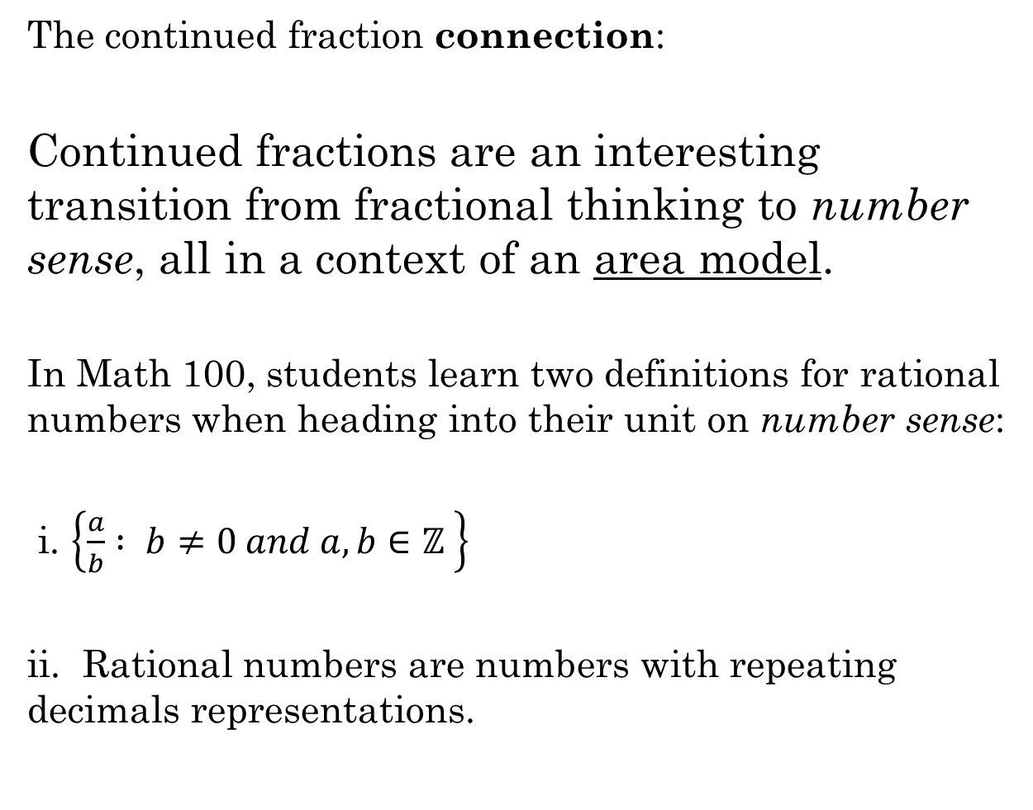
The continued fraction connection:
Continued fractions are an interesting transition from fractional thinking to number sense, all in a context of an area model.
In Math 100, students learn two definitions for rational numbers when heading into their unit on number sense:
i. $\left\{\frac{a}{b} : b≠0 and a, b∈ℤ \right\}$
ii. Rational numbers are numbers with repeating decimals representations.

Slide 19


Area model representations of continued fractions:
Ex. $\frac{45}{16}$

Slide 20


Area model representations of continued fractions:
Ex. $\frac{45}{16}$
$$45=16∙2+13$$
$$\frac{45}{16}=2+\frac{13}{16}=2+\frac{1}{\frac{16}{13}}$$

Slide 21


Area model representations of continued fractions:
Ex. $\frac{45}{16}$
$$45=16∙2+13$$
$$\frac{45}{16}=2+\frac{13}{16}=2+\frac{1}{\frac{16}{13}}$$
$$16=13∙1+3$$
$$\frac{16}{13}=1+\frac{3}{13}$$

Slide 22


Area model representations of continued fractions:
Ex. $\frac{45}{16}$
So far: $\frac{45}{16}=2+\frac{1}{\frac{16}{13}}=2+\frac{1}{1+\frac{3}{13}}=2+\frac{1}{1+\frac{1}{\frac{13}{3}}}$
$$13=3∙4+1$$
$\frac{13}{3}=4+\frac{1}{3}$; $\frac{45}{16}=\left[2, 1, 4, 3\right],$ see it in the diagram?

Slide 23
This expression relates directly to the geometry of the rectangle-as-squares jigsaw as follows: 2 orange squares (16 x 16)
1 brown square (13 x 13)
4 red squares (3 x 3)
3 yellow squares (1 x 1)
Euler’s Theorem 1 geometrically:
Since the (rational) numbers always reduce, that is, the size of the remaining rectangle left over will always have one side smaller than the starting rectangle, then the process will always stop with a final n-by-1 rectangle

Slide 24

Class exercise:
Draw a continued fraction rectangle representation for:
$$\frac{20}{11}$$

Slide 25
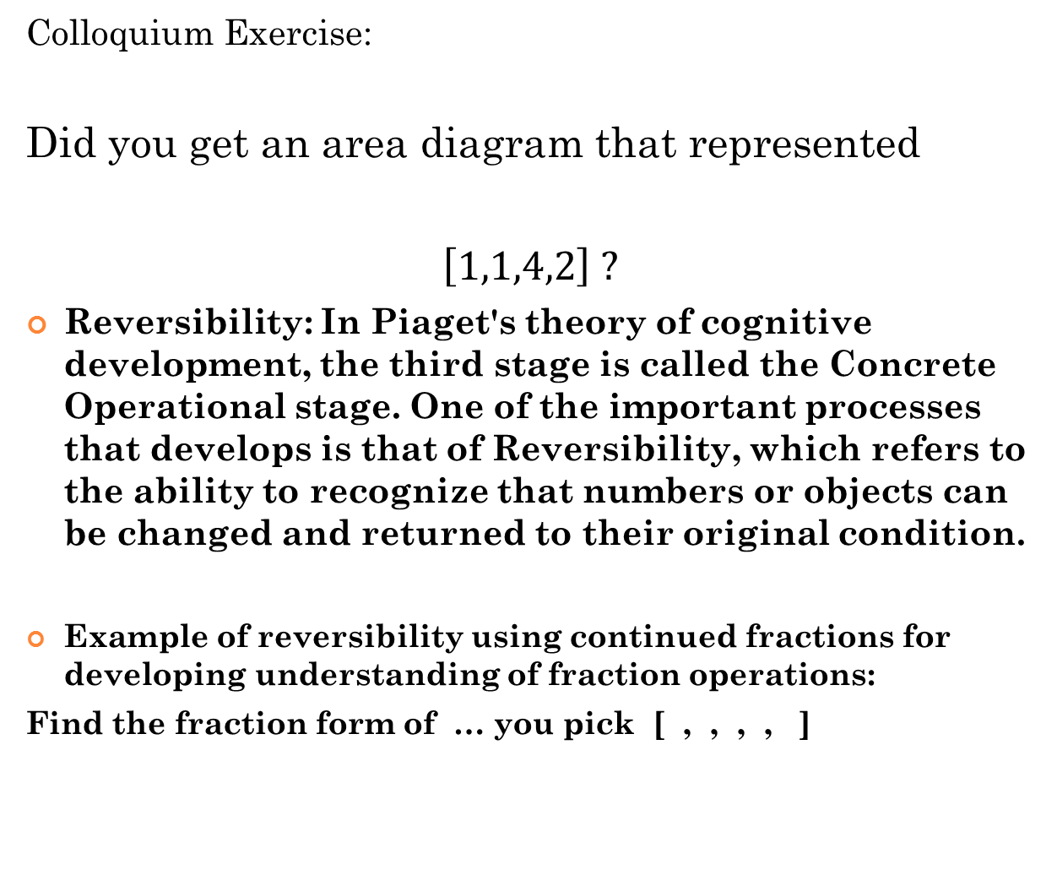
Colloquium Exercise:
Did you get an area diagram that represented
$\left[1,1,4,2\right] ?$
Reversibility: In Piaget's theory of cognitive development, the third stage is called the Concrete Operational stage. One of the important processes that develops is that of Reversibility, which refers to the ability to recognize that numbers or objects can be changed and returned to their original condition.
Example of reversibility using continued fractions for developing understanding of fraction operations:
Find the fraction form of … you pick [ , , , , ]

Slide 26
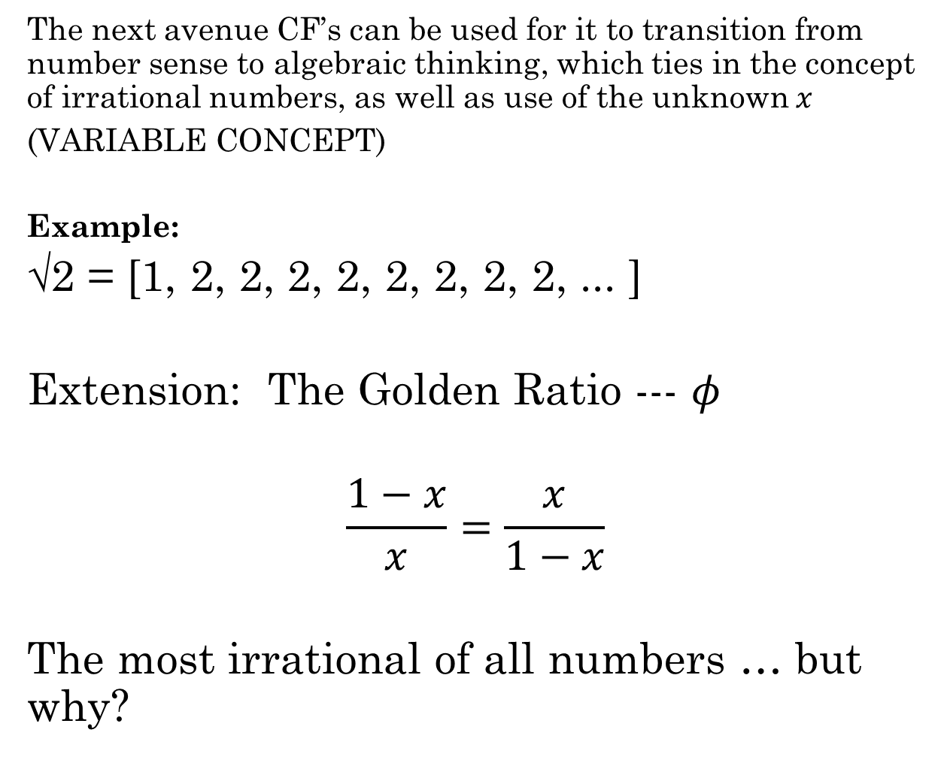
The next avenue CF’s can be used for it to transition from number sense to algebraic thinking, which ties in the concept of irrational numbers, as well as use of the unknown $x$
(VARIABLE CONCEPT)
Example:
√2 = [1, 2, 2, 2, 2, 2, 2, 2, 2, ... ]
Extension: The Golden Ratio --- $φ$
$$\frac{1−x}{x}=\frac{x}{1−x}$$
The most irrational of all numbers … but why?

